Slide 1
NDOW Urban Wildlife
Urban Wildlife: Wildlife that can live or thrive in urban environments. Some urban wildlife, such as mice, rats and birds are synanthropic, ecologically associated with humans. Different types of urban areas support different kinds of wildlife.
Synanthropic : a member of a species of wild animal and/or plant of various kinds that live near, and benefit from, an association with humans and the somewhat artificial habitats that humans create around them. Those habitats include houses, gardens, farms, roadsides, garbage dumps, and so on.

Slide 2
NDOW Urban Wildlife
Three regions (Western, Eastern and Southern)
We work somewhat independently on Urban Wildlife issues due to the divers needs across the state.
Seasonal variation in call and response volumes.
Populations
Wildlife

Slide 3
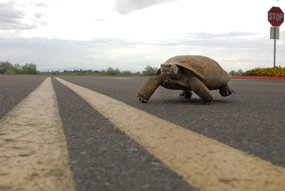
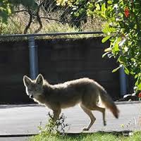
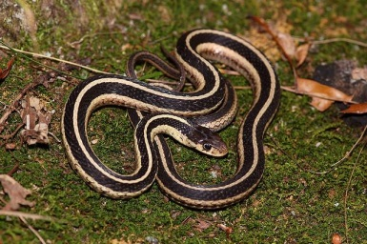
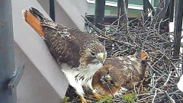
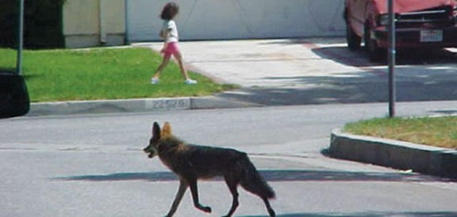
Southern Region Las Vegas, Pioche, Henderson, Tonopah
Issues
Waterfowl/aquatic birds
injured at urban parks
Tangled in fishing line
Burrowing owls
displaced by urban development
Owls and raptors
injured or young fall out of nests
Snakes of various species on people’s property
Usually non-venomous species that we try to educate the public about.
Desert tortoise
Tricky confirming whether an individual is an escaped “pet”, or a wild tortoise displaced by development or Wild.
Woodpeckers with a knack for drilling into stucco
Coyote calls

Slide 4
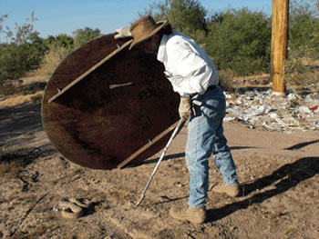
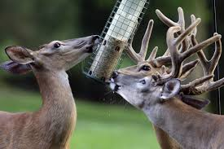
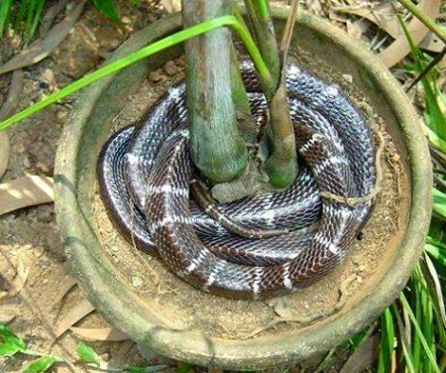
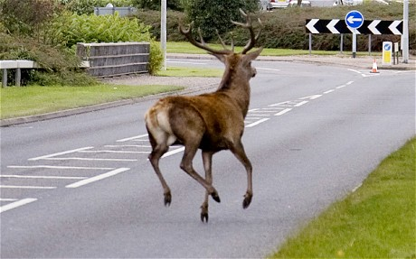
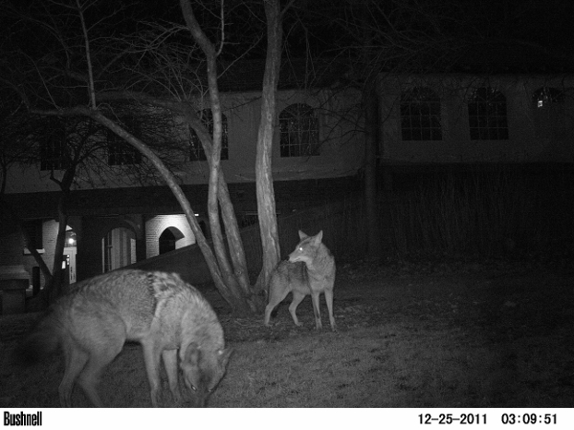
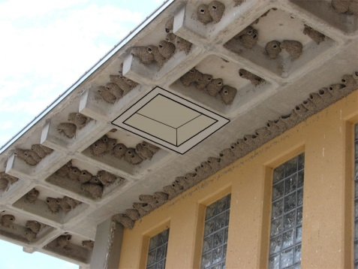
Eastern Region Elko, Ely, Eureka, Battle Mountain
Owls and Raptors
Nesting
Dive-bombing dogs
Eating birds at the feeders
Injured
Small birds
Nesting in bushes
ID them
Snakes / reptiles
In buildings
In yard-planters, garden, dog house
Small mammals (mice, rabbits, squirrels, Bats)
Eating gardens
Making messes in the yard
To many of them around the house

Slide 5
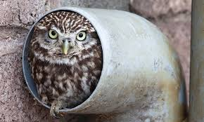
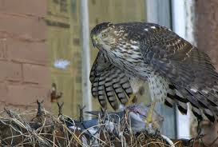
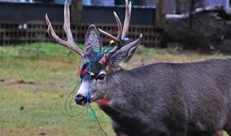
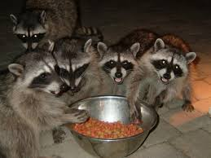
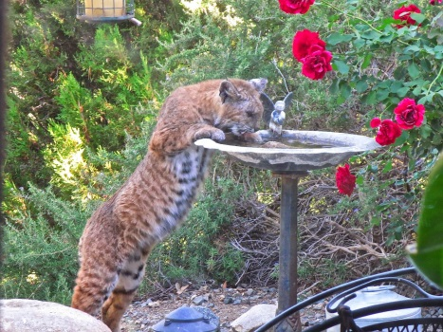
Western Region Reno, Carson City, Winnemucca, Fallon, Yerington
Owls and Raptors
Nesting
Dive-bombing dogs
Eating birds at the feeders
Injured
Birds / woodpeckers
Nesting
Injured
Burrowing into the house stucco
Snakes / reptiles
In buildings
In yard-planters, garden, dog house
Small mammals (mice, rabbits, squirrels, bats)
Eating gardens
Making messes in the yard
To many of them around the house
Medium & Large mammals
Coyote, deer, bobcat, raccoon

Slide 6
Western Region calls
July and August
Top 5
Hawks & Owls
Coyote
Birds
Deer
Small & Medium mammals
818 Calls
360 hours spend on calls in the Western region.
Of these call 22 needed to have physical responses equaling roughly 500 miles and 60 hours.

Slide 7
New positions Reno Las Vegas
Reno & Las Vegas Position
Primary duties
Answer urban wildlife calls.
Educate the public on living with wildlife.
Respond were needed to urban wildlife calls posing a public safety concern.
These responses will be limited (injured hawks, venomous snakes.)

